Slide 1
wake up

Slide 2
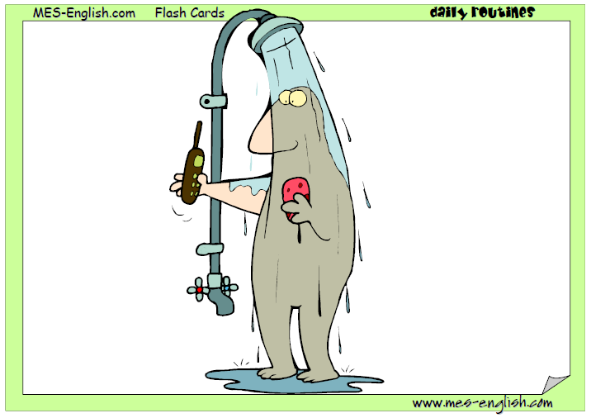
take a shower

Slide 3
brush your hair

Slide 4
brush your teeth

Slide 5
get dressed

Slide 6
make your bed

Slide 7
go to school

Slide 8
go home

Slide 9
do homework

Slide 10
go to bed

Slide 11
drive to work

Slide 12
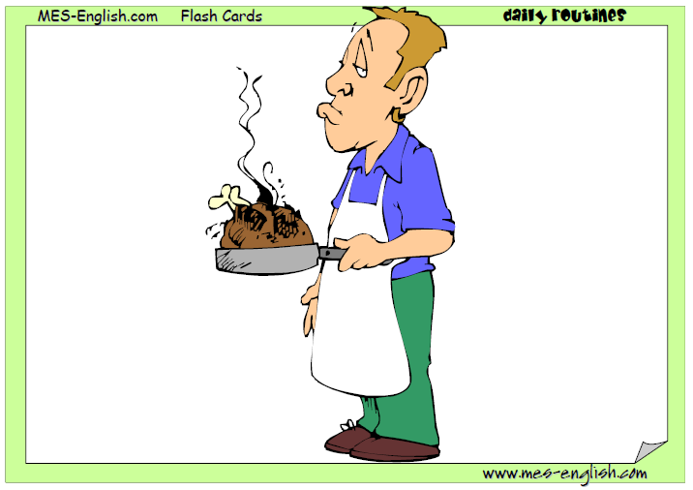
Cook lunch

Slide 13
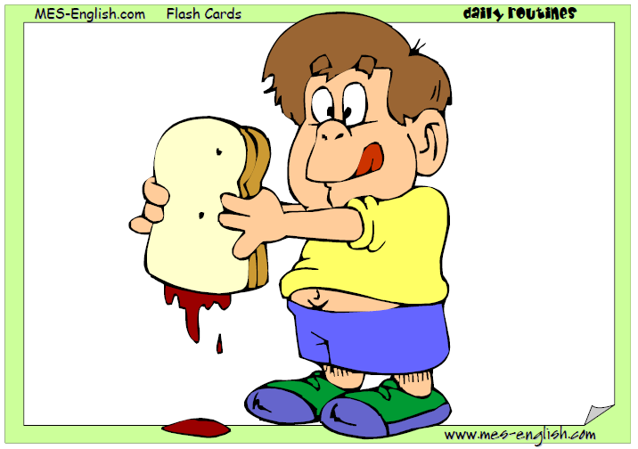
eat lunch

Slide 14
Drink water/soda

Slide 15
Read a book

Slide 16
Study English

Slide 17
watch TV

Slide 18
Sing

Slide 19
Dance

Slide 20
go for a walk

Slide 21
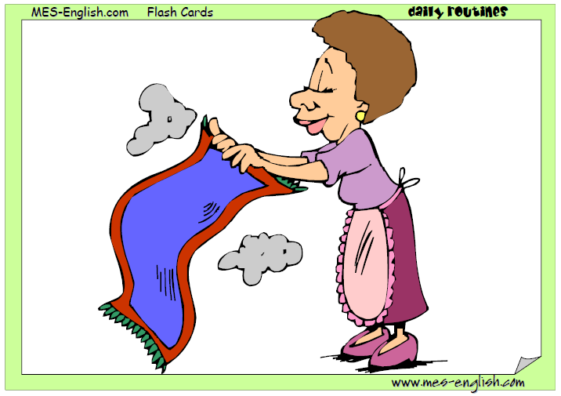
clean the house

Slide 22
take a nap

Slide 23
Sleep

Slide 24
Take a picture

Slide 25
Cut

Slide 26
Hit

Slide 27
Hold

Slide 28
Use a computer

Slide 29
Fly

Slide 30
Take a bath

Slide 31
Go

Slide 32
Come

Slide 33
Ride

Slide 34
Laugh

Slide 35
Cry

Slide 36
Swim

